Slide 1
Lecture 22 nother generative graph example tandem worklists

Slide 2
A generated graph
(define M4
(list O O O O O
O W W W O
O W O O O
O W O W W
W W O O O))
(make-pos 0 0) has no field that holds a list of subs
BUT
(next-positions (make-pos 0 0)) generates (list (make-pos 0 1) (make-pos 1 0))

Slide 3
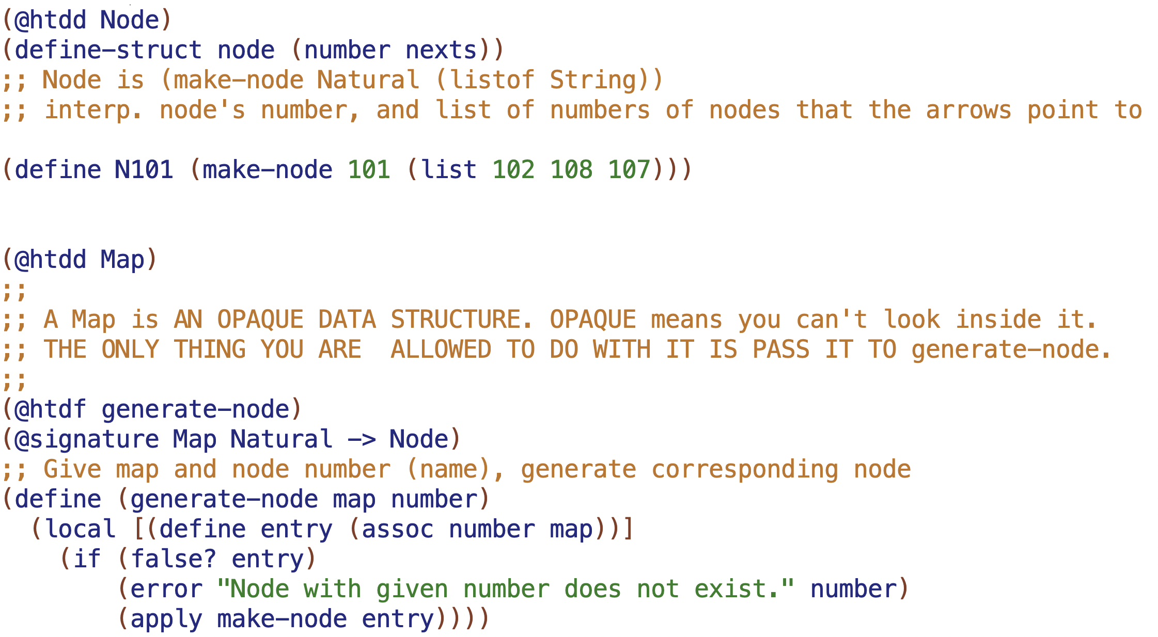
101
102
108
107
treat this as a primitive
103
(generate-node MAP 101) generates
(make-node 101 (list 102 108 107)))
104
105
106

Slide 4
1
101
2
6
102
108
107
3
5
8
103
4
9
104
105
106
11
12
15
16
provided MAP has 3 separate graphs in it
13
14
17
18

Slide 5
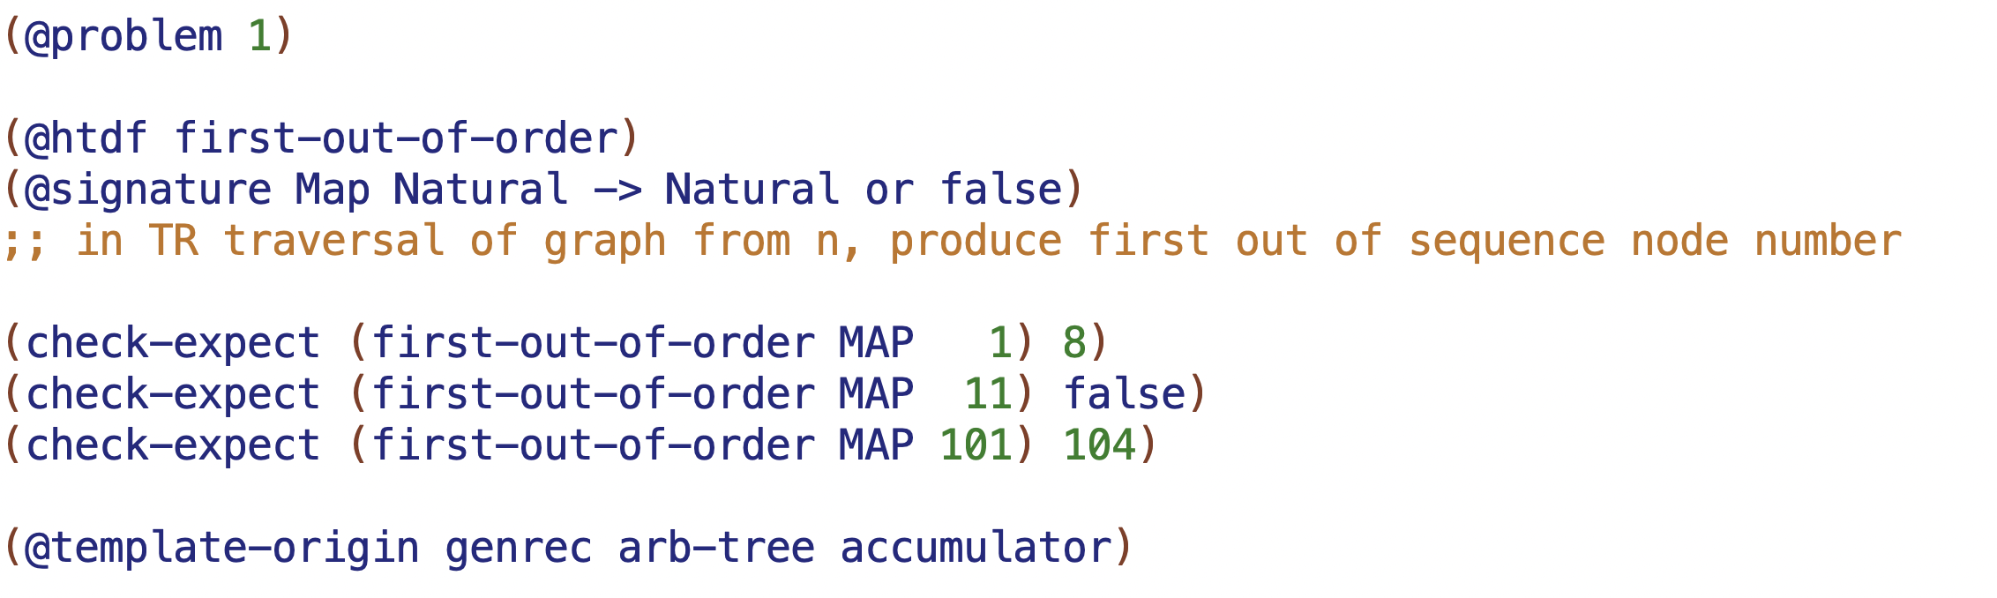
1
2
6
3
5
8
4
9

Slide 6
101
102
108
107
103
104
105
106

Slide 7
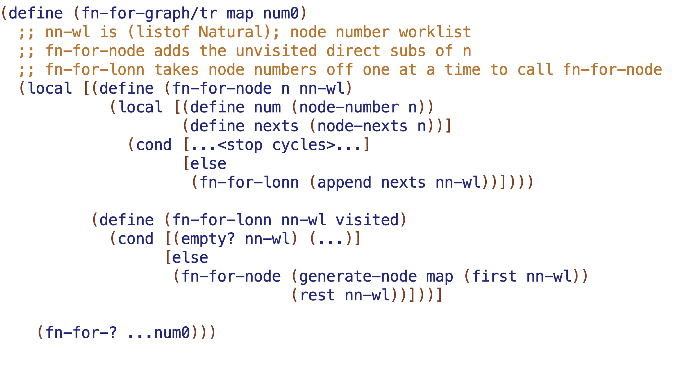

Slide 8
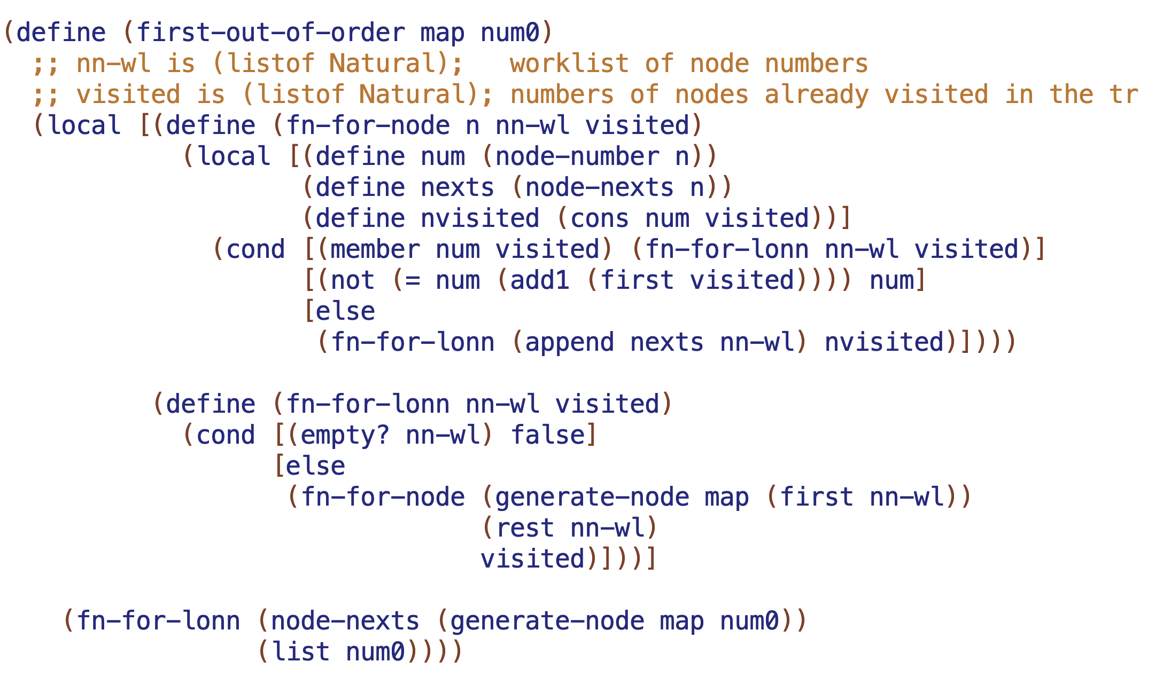

Slide 9
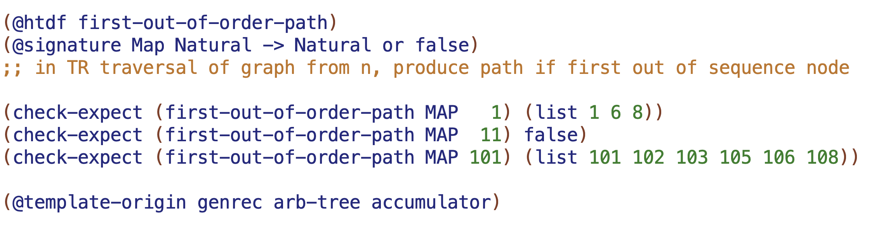
1
2
6
3
5
8
4
9

Slide 10
1
2
6
3
5
8
4
9

Slide 11
101
102
108
107
103
104
105
106

Slide 13
